Slide 1

Relations, Functions, and Matrices
Mathematical Structures for Computer Science
Chapter 5
Copyright © 2014 W.H. Freeman & Co. MSCS Slides Section 5.4

Slide 2
Functions
DEFINITIONS: TERMINOLOGY FOR FUNCTIONS Let S and T be sets.
  A function (mapping) f from S to T,
  f : S → T, is a subset of S × T, where each member of S appears exactly once as the first component of an ordered pair.
  S is the domain and T the codomain of the function.
  If (s,t) belongs to the function, then t is denoted by f(s);
  t is the image of s under f,
  s is a preimage of t under f,
  and f is said to map s to t.
  For A ⊆ S, f (A) denotes { f (a) ⏐ a ∈ A}.
Section 5.4
Functions

Slide 3
Functions
There are three parts to a function:
  A set of starting values (the domain)
  A set from which associated values come (the codomain)
  The association itself
Section 4.4
Functions

Slide 4
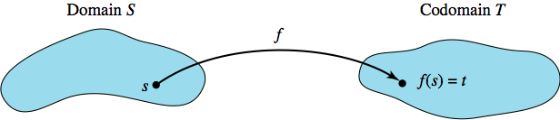
Functions
Here f is a function from S to T, symbolized f: S → T.
  S is the domain and T is the codomain.
  The association itself is a set of ordered pairs,
  Each order pair has the form (s,t) where s ∈ S, t ∈ T
  And t is the value from T that the function associates with the value s from S; t = f (s).
Section 5.4
Functions

Slide 5
Functions
A function from S to T is a subset of S × T with certain restrictions on the ordered pairs it contains.
  By the definition of a function, a binary relation that is one-to-many (or many-to-many) cannot be a function.
  Each member of S must be used as a first component.
The definition of a function includes functions of more than one variable. We can have a function f : S₁ × S₂ × ... × S_{n} → T that associates with each ordered n-tuple of elements (s₁, s₂, ... , s_{n}),
s_{i} ∈ S_{i}, a unique element of T.
Section 5.4
Functions

Slide 6
Functions
The floor function ⎣x⎦ associates with each real number x the greatest integer less than or equal to x.
The ceiling function ⎡x⎤ associates with each real number x the smallest integer greater than or equal to x.
⎣2.8⎦ = 2, ⎡2.8⎤ = 3. Both the floor function and the ceiling function are functions from R to Z.
See In-Class Worksheet
Section 4.4
Functions

Slide 7
Functions
For any integer x and any positive integer n, the modulo function, denoted by f (x) = x mod n, associates with x the nonnegative remainder when x is divided by n.
One can write x as x = qn + r, 0 ≤ r ≤ n, where q is the quotient and r is the remainder,
So the value of x mod n is r.
Example: 49 mod 8 is 1
or 49 mod 8 = 1
or qn + r = 6 x 8 + 1 = 49
where n=8, q=6, and r=1
Section 5.4
Functions

Slide 8
Functions
Not all functional associations can be described by an equation.
Technically, the equation only describes a way to compute associated values.
g: R → R, where g(x) = x³.
f : Z → R, given by f (x) = x³ is not the same function as g. The domain has been changed, which changes the set of ordered pairs.
  Why?......
  Because Real Numbers other than integers are eliminated from consideration because they are not in the domain of f
Section 5.4
Functions

Slide 9
Equal Functions
DEFINITION: EQUAL FUNCTIONS
Two functions are equal if they have the same domain, the same codomain, and the same association of values of the codomain with values of the domain.
To show that two functions with the same domain and the same codomain are equal, one must show that the associations are the same.
This can be done by showing that, given an arbitrary element of the domain, both functions produce the same associated value for that element; that is, they map it to the same place.
  How would you show they are not equal?
    By showing for a specific value in the domain they do not give the same value from the codomain.
Section 5.4
Functions

Slide 10
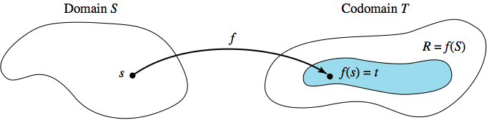

Onto Functions
DEFINITION: ONTO (SURJECTIVE) FUNCTION
A function f: S → T is an onto, or surjective, function if the range of f (the set of all images of S under f) equals the codomain of f.
In every function with range R and codomain T, R ⊆ T.
To prove that a given function is onto,
  Show that T ⊆ R; then it will be true that R = T.
  Show that an arbitrary member of the codomain is a member of the range, that is, it has a preimage in the domain.
g: R → R where g(x) = x³ is an onto function.
  Any r in R has a preimage in R of
Section 5.4
Functions

Slide 11
One-to-One Functions
DEFINITION: ONE-TO-ONE (INJECTIVE) FUNCTION A function f: S → T is one-to-one, or injective, if no member of T is the image under f of two distinct elements of S.
The one-to-one idea here is the same as for binary relations in general, except that every element of S must appear as a first component in an ordered pair.
To prove that a function is one-to-one, we assume that there are elements s₁ and s₂ of S with f (s₁) = f (s₂) and then show that s₁ = s₂.
The function g: R → R defined by g(x) = x³ is one-to-one because if x and y are real numbers with g(x) = g(y), then x³ = y³ and x = y.
Section 5.4
Functions

Slide 12
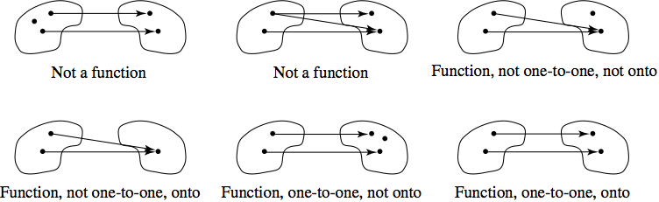
Bijections
DEFINITION: BIJECTIVE FUNCTION
A function f:S → T is bijective (a bijection) if it is both one-to-one and onto.
The function g: R → R given by g(x) = x³ is a bijection.
Various function properties are shown below (domain on the left, codomain on the right)
Section 5.4
Functions

Slide 13
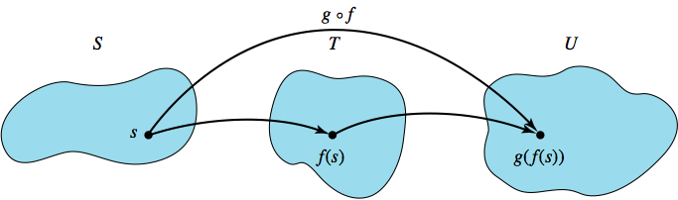
Composition of Functions
DEFINITION: COMPOSITION FUNCTION
Let f: S → T and g: T → U. Then the composition function, g ° f, is a function from S to U defined by (g ° f )(s) = g( f (s)).
The function g ° f is applied right to left; function f is applied first and then function g.
Function composition preserves the properties of being onto and being one-to-one.
THEOREM ON COMPOSING TWO BIJECTIONS The composition of two bijections is a bijection.
Section 5.4
Functions

Slide 14
Compositions of Functions
Example:
f(x) = x²
g(x) = ⎣ x ⎦
f ∙ g = f( g(x) ) = f( ⎣ x ⎦ )
Is not the same as
g ∙ f = g( f(x) ) = g(x²)
Let x = 2.34 then we have the following:
f(2.34) = (2.34)² = 5.4756
g( ⎣ 2.34 ⎦ ) = 2
(f ∙ g) (x) = (f ∙ g) (2.34) = f ( g(2.34) ) = f( ⎣ 2.34 ⎦ ) = f(2) = (2)² = 4
(g ∙ f) (x) = (g ∙ f) (2.34) = g( f(2.34) ) = g( (2.34)² ) = g( 5.4756 ) = 5
Simple evaluations of the individual functions
Section 4.4
Functions

Slide 15
Inverse Functions
Let f: S → T be a bijection. Because f is onto, every t ∈ T has a preimage in S. Because f is one-to-one, that preimage is unique.
The function that maps each element of a set S to itself, that is, that leaves each element of S unchanged, is called the identity function on S and denoted by i_{S}.
DEFINITION: INVERSE FUNCTION Let f be a function, f: S → T. If there exists a function g: T → S such that g ° f = i_{S} and f ° g = i_{T}, then g is called the inverse function of f, denoted by f ⁻¹.
THEOREM ON BIJECTIONS AND INVERSE FUNCTIONS
Let f: S → T. Then f is a bijection if and only if f ⁻¹ exists.
As an example the Function:
f *g = (x²)^{1/2}
where:
f(s) = x²
and
g(t) = y^{1/2}
Section 5.4
Functions

Slide 16
Permutation Functions
DEFINITION: PERMUTATIONS OF A SET For a given set A, S_{A} = { f ⏐ f: A → A and f is a bijection}. S_{A} is thus the set of all bijections of set A into (and therefore onto) itself; such functions are called permutations of A.
If f and g both belong to S_{A}, then they each have domain = range = A.
If A = {1, 2, 3, 4}, one permutation function of A, call it f, is given by f = {(1,2), (2,3), (3,1), (4,4)}.
A shorter way to describe the permutation f is to use cycle notation and write f = (1, 2, 3),
  Which is understood to mean that f maps each element listed to the one on its right, the last element listed to the first, and an element of the domain not listed is listed to itself – that being element 4 of the domain.
Section 5.4
Functions

Slide 17
Permutation Functions
Example
Given:
Let A = {1, 2, 3, 4, 5} where g Ɛ S_{A}
and in cycle form is: g = (2, 4, 5, 3)
Show the array form for g:
If a value in A does not show up in the cycle form of the function then it is mapped to itself
Note: in cycle form the mapping is:
1 to 1
2 to 4
3 to 2
4 to 5
5 to 3
1 2 3 4 5
1 4 2 5 3
g =
Section 4.4
Functions

Slide 18
Permutation Functions
If A = {1, 2, 3, 4}, Given f & g in cycle form:
f = (1, 2, 3) and g = (2, 3) then
  f ° g = (1, 2, 3) ° (2, 3) = (1, 2)
  g ° f = (2, 3) ° (1, 2, 3) = (1, 3)
  From whence did these results come?....
  Looking at f ° g, we note that one must work from right to left.
  This means evaluate function g first then plug the results in to f
  Considering f ° g: From step 1 and 2 we evaluate g in cycle form for its first term 1:
  from g: 2 → 3
  now plugging 3 into function f
  from f: 3 → 1
  Therefore the composite function f ° g for the first order pair yields
  2 → 1 or the ordered pair (2, 1) or (1, 2)
  Now evaluating the 2nd term in g for f ° g
  from g: 3 → 2
  from f: 2 → 3
  Therefore since 3 → 2 → 3 we have 3 → 3, a self reference so it is not included in the composite function results in cycle form
  Also since 4 from A does not appear in the cycle forms of f or g it is a self reference and does not appear in the composite function cycle form of f ° g
  As a result: f ° g in cycle form = (1, 2) or (2, 1)
Section 5.4
Functions

Slide 19
Permutation Functions
If A = {1, 2, 3, 4}, Given f & g in cycle form:
f = (1, 2, 3) and g = (2, 3) then
  g ° f = (2, 3) ° (1, 2, 3) = (1, 3)
  From whence did these results come?....
  Now Looking at g ° f, we note that one must work from right to left.
  This means evaluate function f first then plug the results in to g
  Considering g ° f: From step 1 and 2 we evaluate f in cycle form for its first term 1:
  from f: 1 → 2
  now plugging 2 into function g
  from g: 2 → 3
  Therefore the composite function g ° f for the first term yields
  1 → 3 or the ordered pair (3, 1) or (1, 3)
Section 5.4
Functions

Slide 20
Permutation Functions
If A = {1, 2, 3, 4}, Given f & g in cycle form:
f = (1, 2, 3) and g = (2, 3) then
  g ° f = (2, 3) ° (1, 2, 3) = (1, 3)
  Now evaluating the 2nd term in f for g ° f
  from f: 2 → 3
  from g: 3 → 2
  Therefore since 2 → 3 → 2 we have 2 → 2, a self reference so it is not included in the composite function results in cycle form
  Now Evaluating the 3rd term in f for g ° f
  from f: 3 → 1
  from g: In g, 1 is a self-reference, therefore 3 → 1 → 1
  this simplifies to 3 → 1 (and this was already covered)
  Also since 4 from A does not appear in the cycle forms of f or g it is a self reference and does not appear in the composite function cycle form of f ° g
  As a result: g ° f in cycle form = (1, 3)
Section 5.4
Functions

Slide 21
Permutation Functions
Alternatively:
  If, however, f and g are members of S_{A} and f & g are disjoint cycles—the cycles have no elements in common—then f ° g = g ° f.
  The permutation that maps each element of A to itself is the identity function on A, i_{A}, also called the identity permutation.
  A permutation on a set that maps no element to itself is called a derangement.
See Worksheet #4: Array, Ordered pairs & Cycle Form
Section 4.4
Functions

Slide 22
How Many Functions?
THEOREM ON THE NUMBER OF FUNCTIONS WITH FINITE DOMAINS AND CODOMAINS
If ⏐S⏐ = m and ⏐T⏐ = n, then:
  The number of functions f: S → T is n^{m}.
  The number of one-to-one functions f: S → T, assuming
  m ≤ n, is n!/(n − m)!
  The number of onto functions f: S → T, assuming m ≥ n, is
  n^{m} − C(n, 1)(n − 1)^{m} + C(n, 2)(n − 2)^{m} − C(n, 3)(n − 3)^{m}
  +...+ (−1)^{n − 1}C(n, n − 1)(1)^{m}
For example, let S = {A, B, C} and T = {a, b}. Find the number of functions from S onto T.
  2³ − C(2, 1)(1)³ = 8 − 2 • 1 = 6
Section 5.4
Functions

Slide 23
Equivalent Sets
Remember the power set, p, a combination of all possible subsets
DEFINITIONS: EQUIVALENT SETS AND CARDINALITY
A set S is equivalent to a set T if there exists a bijection
f: S → T. Two sets that are equivalent have the same cardinality.
The notion of equivalent sets allows us to extend our definition of cardinality from finite to infinite sets.
If S is equivalent to T, then all the members of S and T are paired off by f in a one-to-one correspondence.
CANTOR’S THEOREM
For any set S, S and ℘(S) are not equivalent.
  The set N is denumberable, ℘(N) is not equivalent to N, so ℘(N) is not a denumerable set.
Section 5.4
Functions

